Slide 1
CSE 260
BRAC University

Slide 2
Karnaugh Maps
CSE260 Digital Logic Design
Khadija Rasul
Aniqua Zereen
CSE260 Digital Logic Design

Slide 3
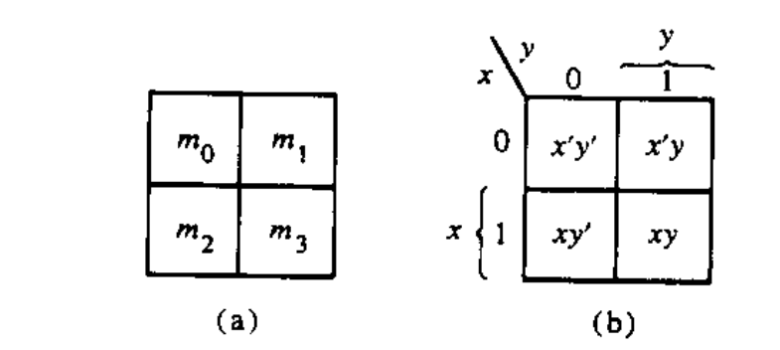
The map method
The map method provides a simple procedure for minimizing Boolean functions.
The map is made up of squares where each square represent a minterm.
We represent each minterm of an equation by ‘1’s
We groups the adjacent ‘1’s in groups of 2, groups of 4 or groups of 8 and so on.
In those grouping try to find the common literal.
The map method is often known as Karnaugh Map or Veitech Diagram. In short we will call it K-map

Slide 4
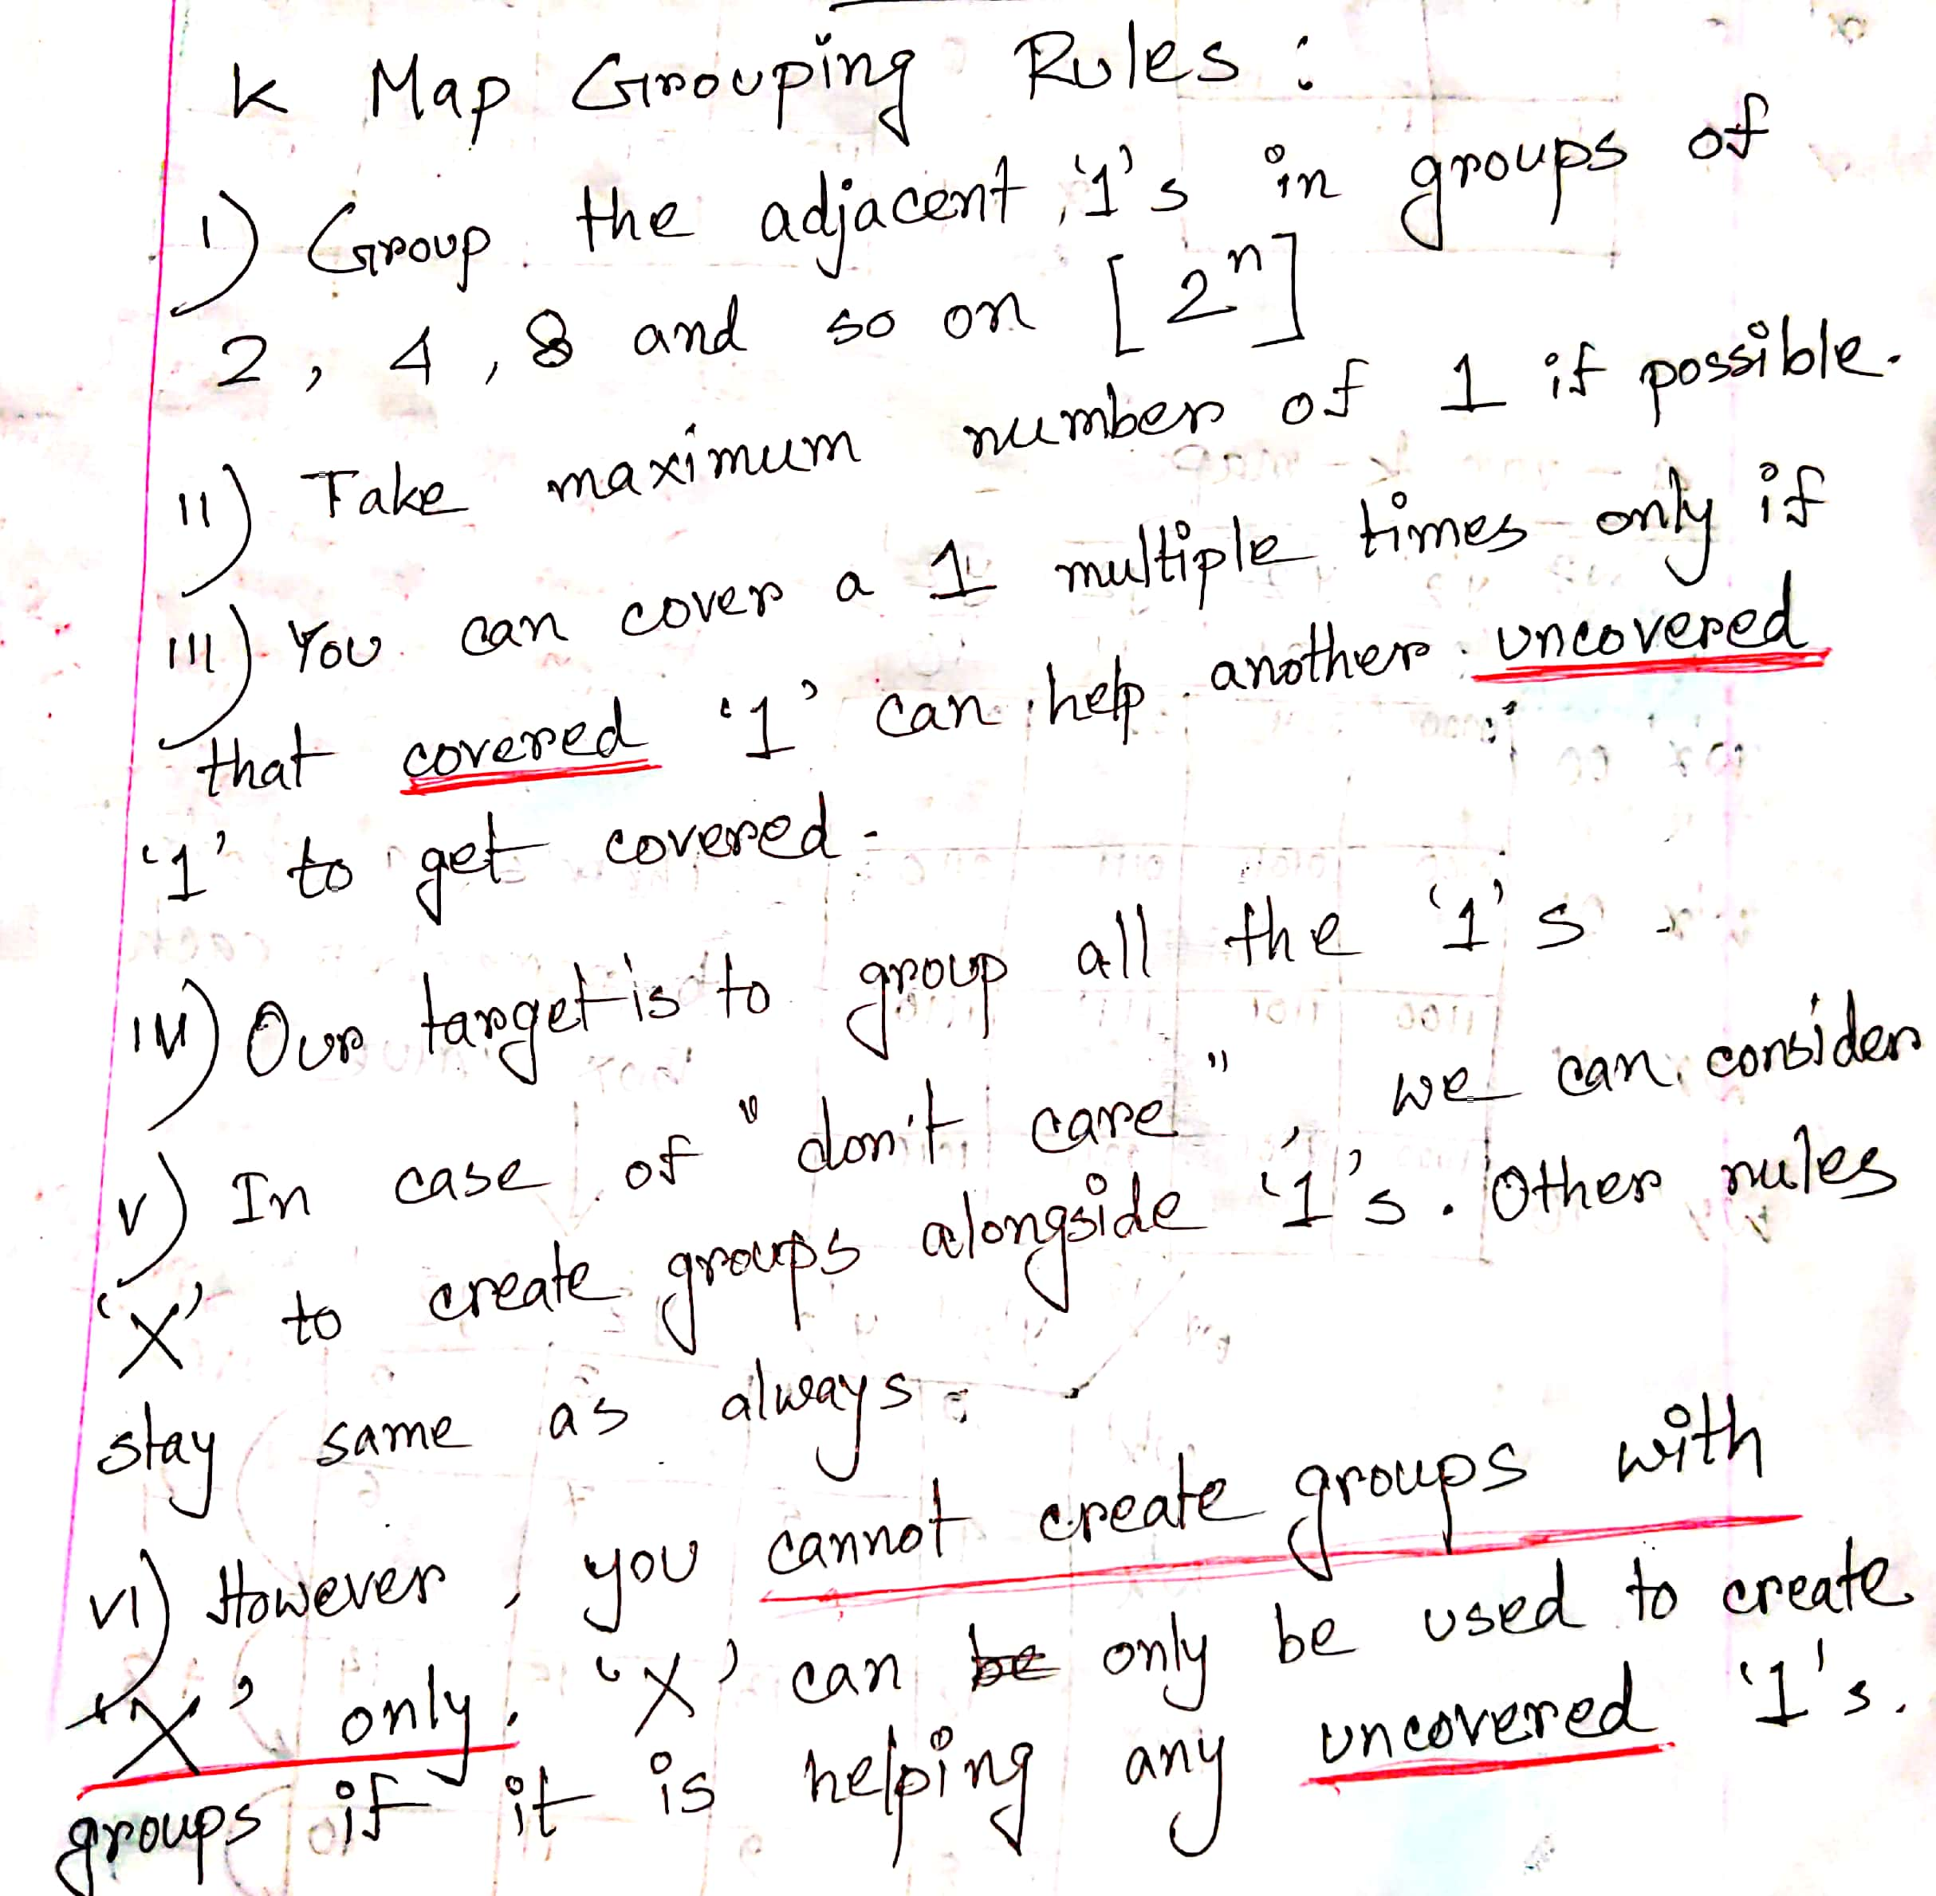

Slide 5
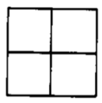
Two variable map
There are 4 minterm of 2 variable; hence the map is four squares, one for each minterm.
Only 1 bit changes
Only 1 bit changes
00
01
10
11

Slide 6
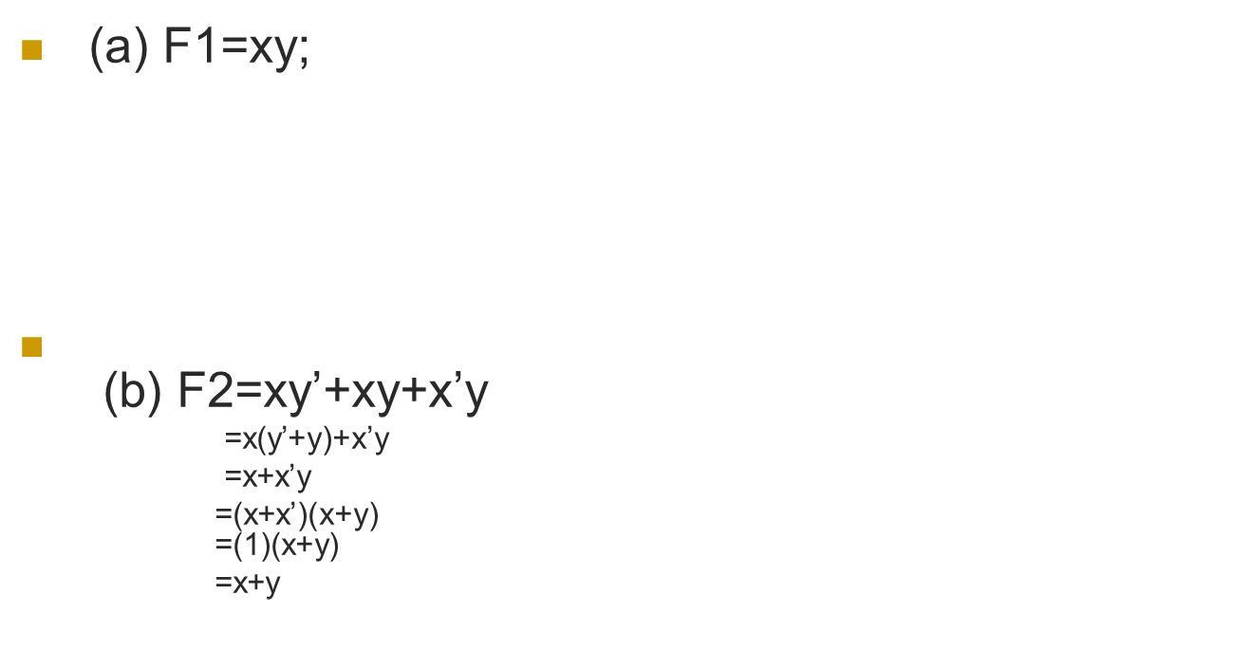
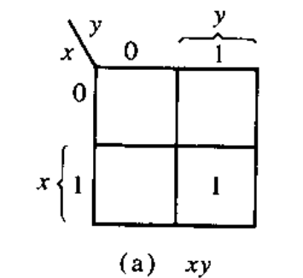
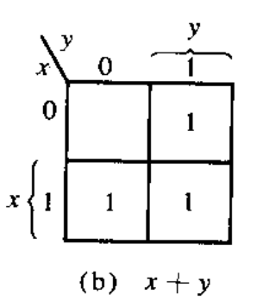
Representing function in K-map

Slide 7
Try it yourself
F=xy’+x’y’+x’y,
Simplify the equation using k-map

Slide 8
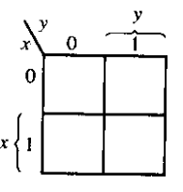
Solution
F=xy’+x’y’+x’y=x’+y’
1
1
1

Slide 9
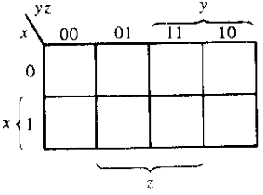
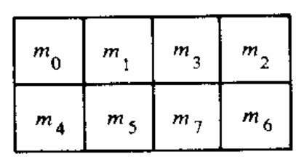
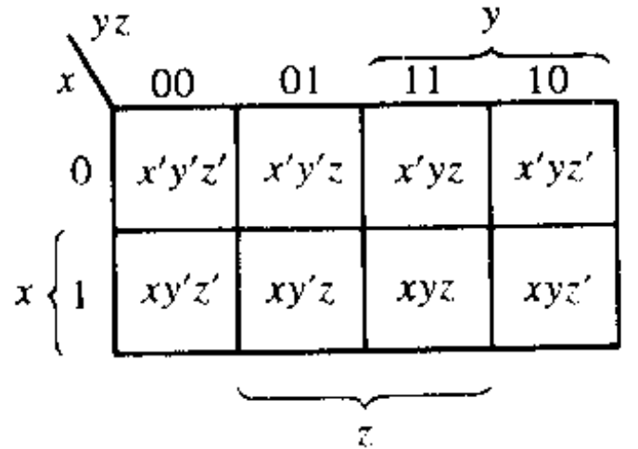
Three variable map
Sequence in 3-variable map is not in binary sequence but in reflected code. In reflected code, at a time only 1 bit changes from 0 to 1 and 1 to 0.
Numbering of minterms follow binary numbers. Example m5 is at 101 i.e. row 1 and column 01.
Note: Any 2 adjacent square differ by 1 variable ( which is primed in one and unprimed in the other )
000
001
011
010
100
101
111
110

Slide 10
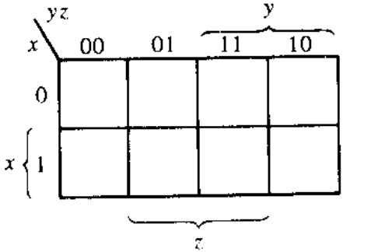
If any 2 adjacent square differ by 1 variable ( which is primed in one and unprimed in the other ) and they are grouped, then any 2 minterms in the adjacent square are ORed, will remove the different term. As a result , we get a single ANDed term of only 2 common literals
F1=∑(5,7)=xy’z+xyz=xz(y’+y)=xz
F2=∑(0,2)=x’y’z’+x’yz'=x’z’(y’+y)=x’z’
1
1
1
1

Slide 11
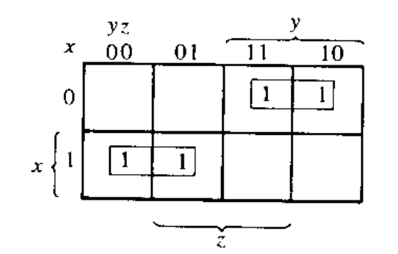
Simplifying functions using k-map
F=∑(2,3,4,5)=x’yz+x’yz’+xy’z’+xy’z
(note: in other words, F= (∑(010,011,100,101) so place ‘1’ in those positions and group the adjacent ones)
F=x’y+xy’
Grouping of 1 can be done in groups of
two ‘1’,four ‘1’,eight ‘1’.…2^n ‘1’.
x’y
xy’

Slide 12
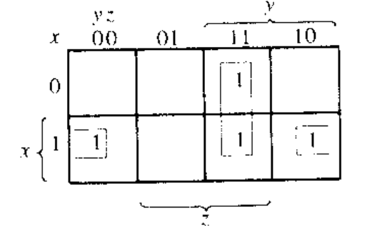
F1=x’yz+xy’z’+xyz+xyz’=xz’+yz
011
100
111
110
yz
Notice even 2 opposite edges of the map are adjacent, thus they can be grouped
xz’

Slide 13
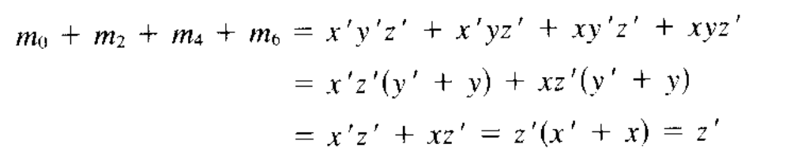
If F=∑(0,2,4,6), then simplify it
000
010
100
110
1
1
=Z’
1
1

Slide 14
Try it yourself
F=∑(0,2,4,5,6), Simplify it.

Slide 15
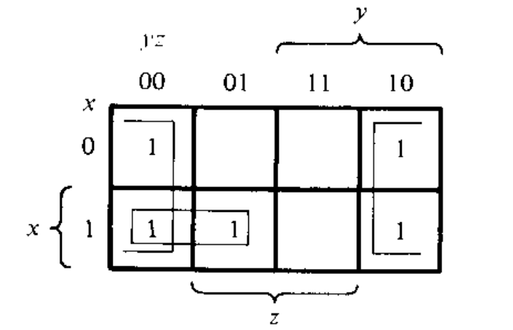
Solution
F= xy’ + z’

Slide 16
Try it yourself:
F=A’C+A’B+AB’C+BC
a) Express it as SOP (i.e. ∑)
b) Simplify it using Kmap

Slide 17
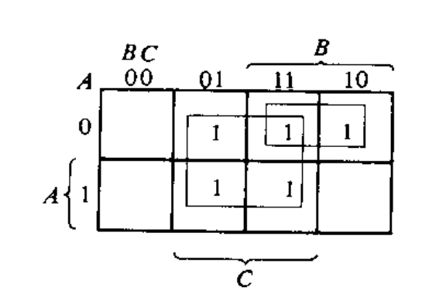
Solution
(a) F= ∑(1,2,3,5,7)
(b)F=C + A’B
To find A’C, coincide A’ (first row) with C( middle 2 column)
To find A’B, coincide A’ (first row) with B( last 2 column)
To find BC, coincide B (last 2 column) with C( middle 2 column)
To find AB’C, is m5( 2nd row 2nd column)

Slide 18
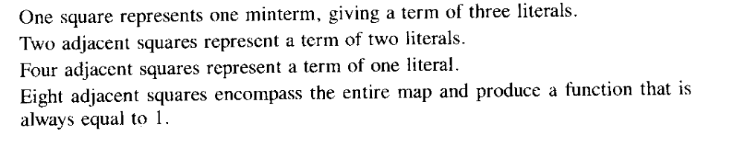
Summary of grouping in 3-variable map

Slide 19
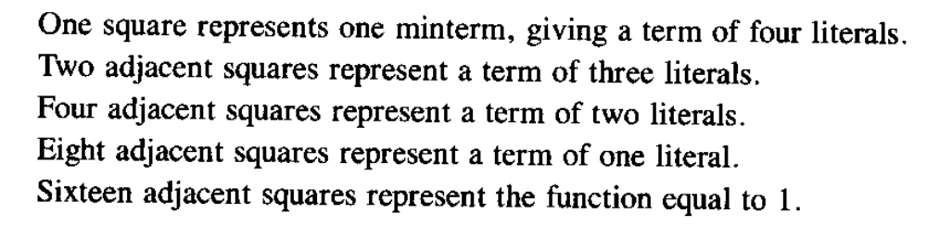
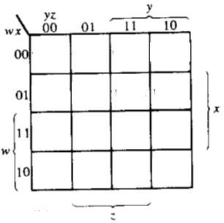
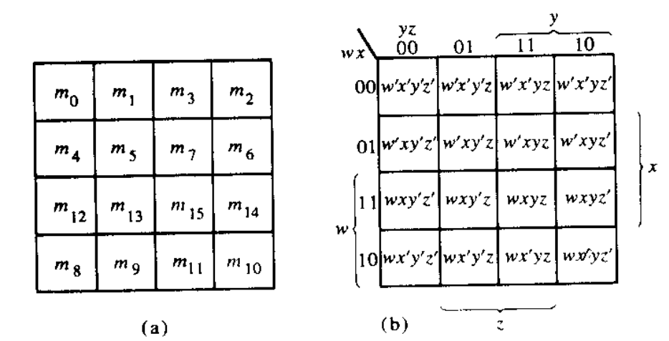
Four variable map
Adjacent squares can be side by side or lie in 4 corner or top-bottom or left-right edge condition. Example, m0 -m2 are adjacent and similarly m3-m11 are adjacent
0000
0001
0011
0010
0100
0101
0111
0110
1100
1101
1111
1110
1000
1001
1011
1010

Slide 20
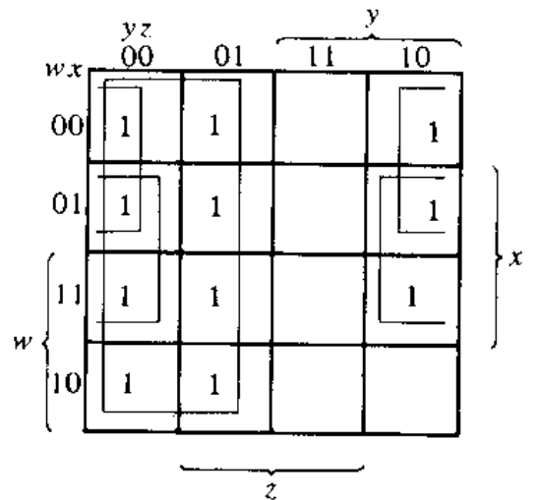
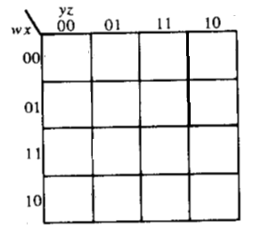
Simplify F=∑(0,1,2,4,5,6,8,9,12,13,14)
Note: it is allowed to use the same ‘1’ more than once.
1
1
1
1
1
1
1
1
1
1
1
F= xz’+ y’+ w’z’

Slide 21
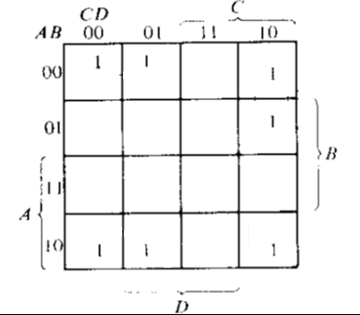
Try it yourself
F=A’B’C’+B’CD’+A’BCD’+AB’C’

Slide 22
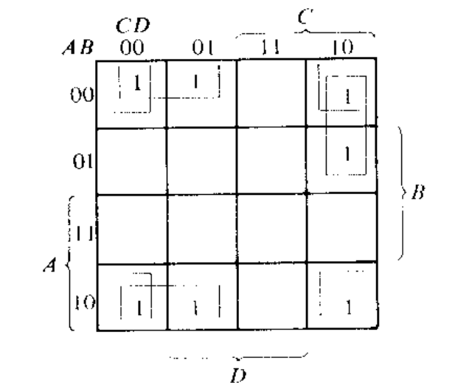
Solution
F=A’B’C’+B’CD’+A’BCD’+AB’C’
F=B’D’+B’C’+A’CD’

Slide 23
Don’t Care condition
Don't cares in a Karnaugh map, or truth table, may be either 1s or 0s, as long as we don't care what the output is for an input condition we never expect to see.
We plot these cells with a special sign, ‘X’, among the normal 1s and 0s.
When forming groups of cells, treat the don't care cell as either a 1 or a 0, or ignore the don't cares. This is helpful if it allows us to form a larger group than would otherwise be possible without the don't cares.
There is no requirement to group all or any of the don't cares. (i.e. do not make any group only consisting the don’t cares). Only use them in a group if it simplifies the logic.

Slide 24
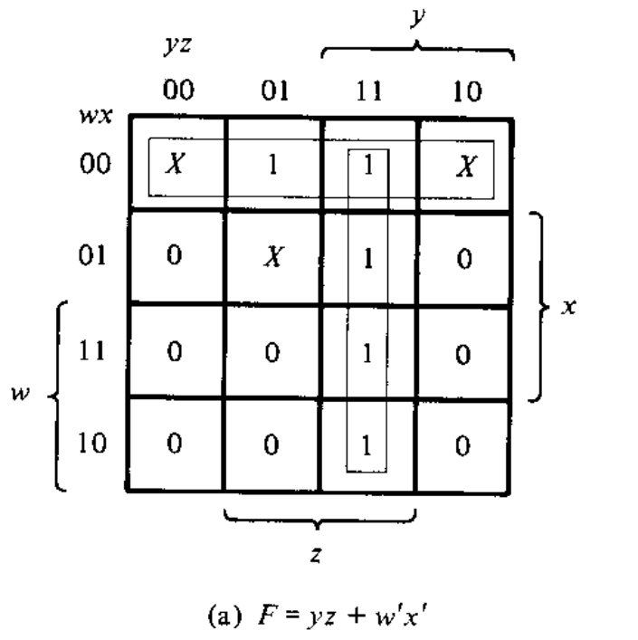
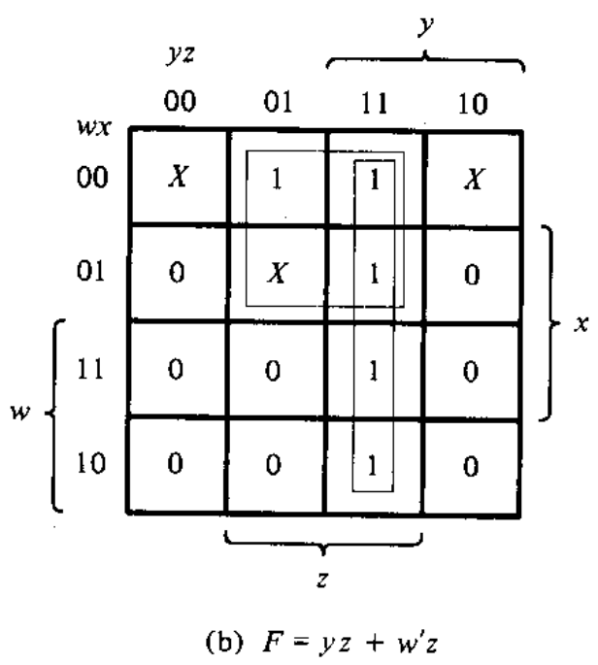
Simplify F(w,x,y,z)= ∑(1,3,7,11,15) and don’t care d(w,x,y,z)= ∑(0,2,5)
Solution: Even though 2 solutions are not same, but either 1 is acceptable. Such scenario only applicable for Don’t care scenarios!

Slide 25
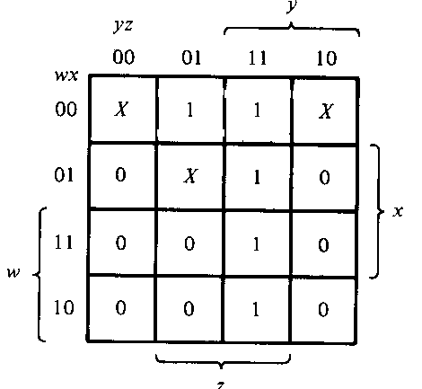

Complement of the function and POS considering don’t cares
F’=z’+wy’
F=(z)(w’+y)

Slide 26
APPLICATIONS OF K-MAP

Slide 27
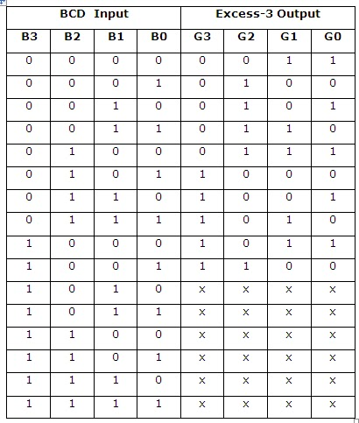

Example 1: Design and draw the circuit diagram of BCD to Excess-3 code converter
Q1.Treat each W, X, Y and Z as a function and write them as SOP
Q2. Based on the SOP, draw the circuit diagram of BCD to Excess-3 code converter
W X Y Z
Any value higher than 9 will result into don’t care output

Slide 28
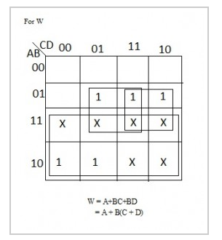
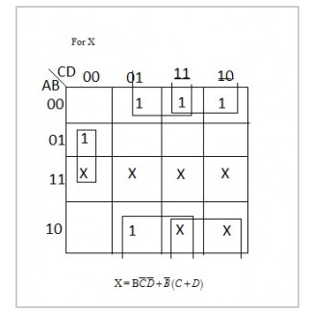
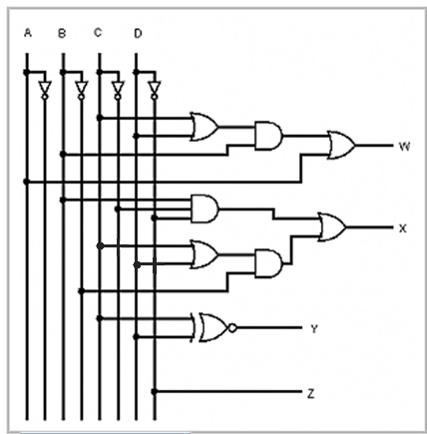
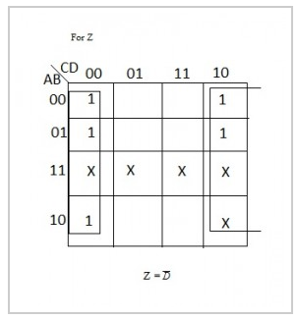
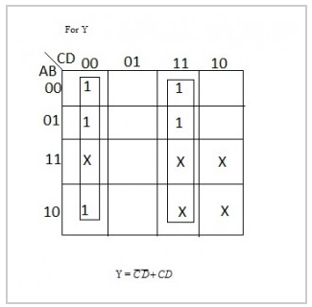

Slide 29
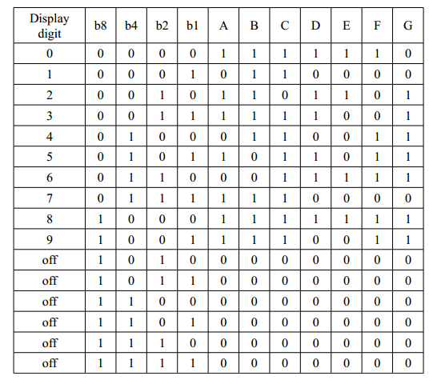
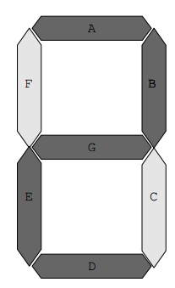
Example 2: 7 segment display board

Slide 30
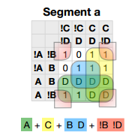
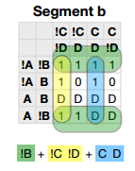
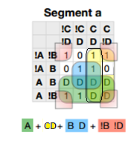
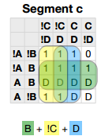
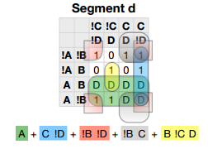
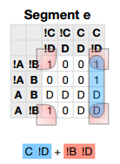
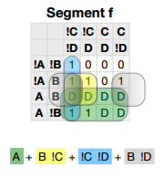
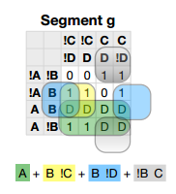

Slide 31
Try it by your self
A car garage has a front door and one window, each of which has a sensor to detect whether it is open. A third sensor detects whether it is dark outside. A security system for the garage follows this rule: the alarm rings if the alarm switch is turned on and either the front door is not closed or it is dark and the side window is not closed.

Slide 32
Solution
SwitchOn | Door | Window | Dark | AlarmRing
0 | 0 | 0 | 0 | 0
0 | 0 | 0 | 1 | 0
0 | 0 | 1 | 0 | 0
0 | 0 | 1 | 1 | 0
0 | 1 | 0 | 0 | 0
0 | 1 | 0 | 1 | 0
0 | 1 | 1 | 0 | 0
0 | 1 | 1 | 1 | 0
1 | 0 | 0 | 0 | 0
1 | 0 | 0 | 1 | 0
1 | 0 | 1 | 0 | 0
1 | 0 | 1 | 1 | 1
1 | 1 | 0 | 0 | 0
1 | 1 | 0 | 1 | 0
1 | 1 | 1 | 0 | 1
1 | 1 | 1 | 1 | 1
WDk
SDr
1
1
1
AlarmRing=SWDk+SDrW
Assuming
AlarmRing = 1 if Alarm rings, 0 otherwise.
Switch On = 1 if alarm switch is on, 0 otherwise.
Door = 1 if door is not closed, 0 otherwise.
Window = 1 if window is not closed.
Dark = 1 if it is dark outside, 0 otherwise.

Slide 33
Solution
WDk
SDr
SwitchOn | Door | Window | Dark | AlarmRing
0 | 0 | 0 | 0 | 0
0 | 0 | 0 | 1 | 0
0 | 0 | 1 | 0 | 0
0 | 0 | 1 | 1 | 0
0 | 1 | 0 | 0 | 0
0 | 1 | 0 | 1 | 0
0 | 1 | 1 | 0 | 0
0 | 1 | 1 | 1 | 0
1 | 0 | 0 | 0 | 0
1 | 0 | 0 | 1 | 0
1 | 0 | 1 | 0 | 0
1 | 0 | 1 | 1 | 1
1 | 1 | 0 | 0 | 0
1 | 1 | 0 | 1 | 0
1 | 1 | 1 | 0 | 1
1 | 1 | 1 | 1 | 1
1
1
1
AlarmRing=SWDk+SDrW
Next Step
You do have to draw the circuit for the above function
You may be asked to draw the circuit using basic gates or universal gates
By now, you should be able to do it yourself. So please try.

